Slide 1





3

Slide 2
Back to Game
Restart Game
Save Game
Exit Game

Slide 4
3
4
5
1

Slide 5
1
2
3
4
5
6

Slide 6
Choose option to Save
1
2
3
4
5
6

Slide 7
Back to Pause Menu

Slide 8

1
2
3
4
5

Slide 9
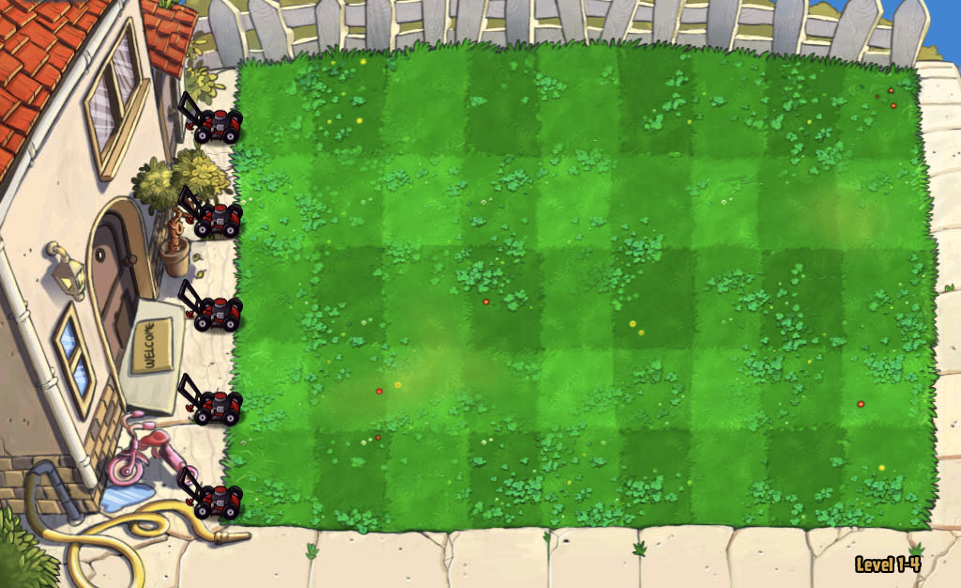
Made by – Himanshu and Udit

Slide 11
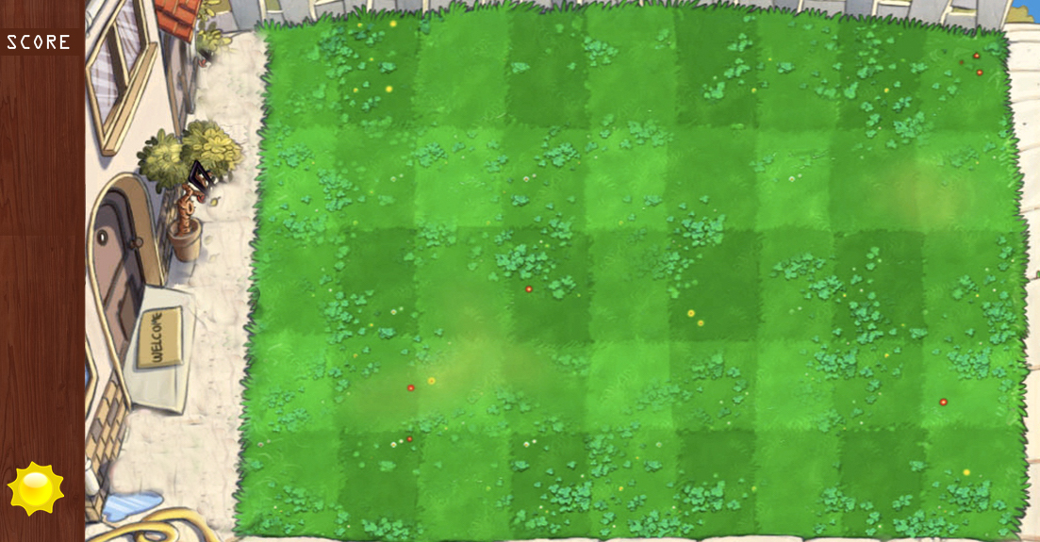

Slide 12
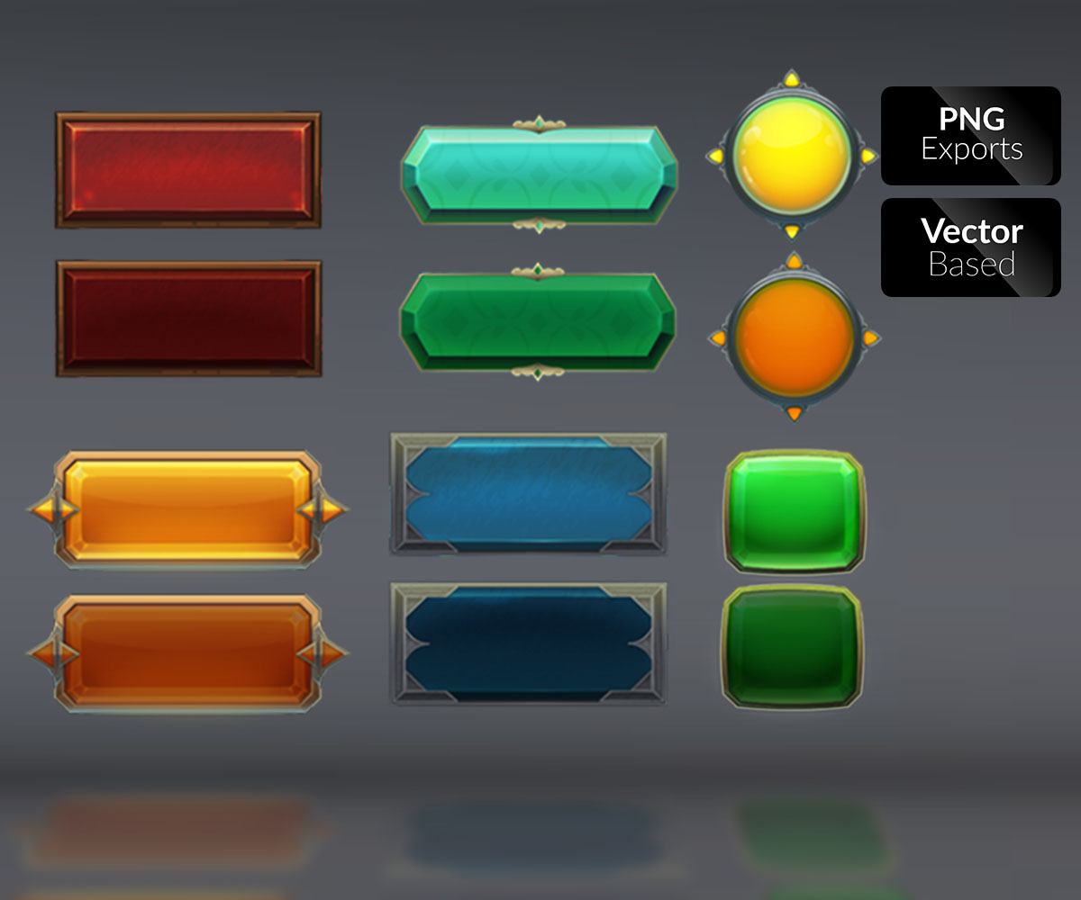
SAVE
RESTART
LOAD GAME
NEW GAME
EXIT

Slide 13
CHOOSE LEVEL

